Slide 1
Bailey’s Bank Churn Report

Slide 2
Agenda
Overview of customer churn issue at Bailey's Bank
Importance of customer retention
Objectives of the analysis

Slide 3

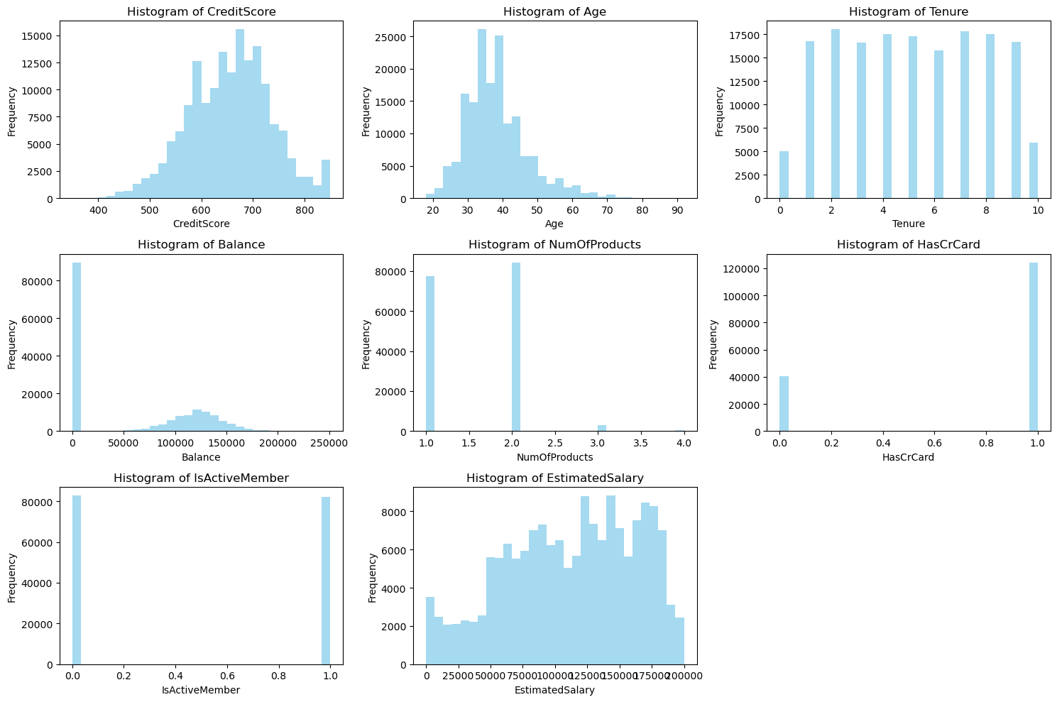
Histograms Credit Score Age Balance Number of Products Is Active Member Estimated Salary
Exploratory Data Analysis (EDA) - Overview

Slide 4

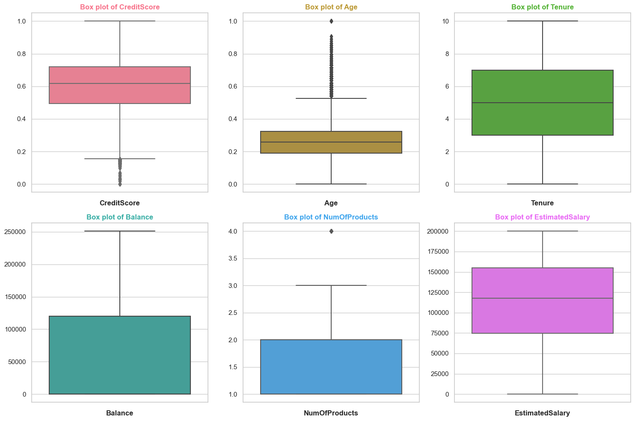
Age is key to customer churn

Slide 5
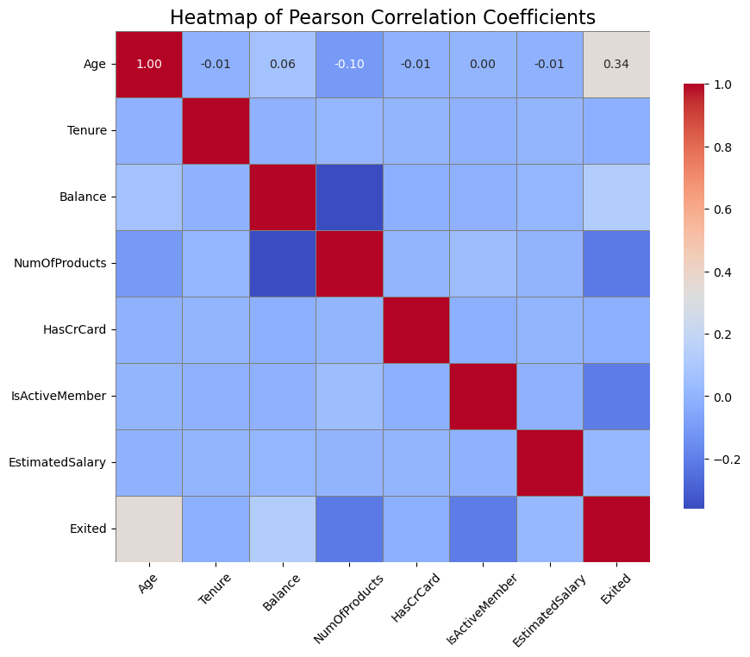
Correlation Analysis
Age correlates directly to churn, no other factor is relevant

Slide 6
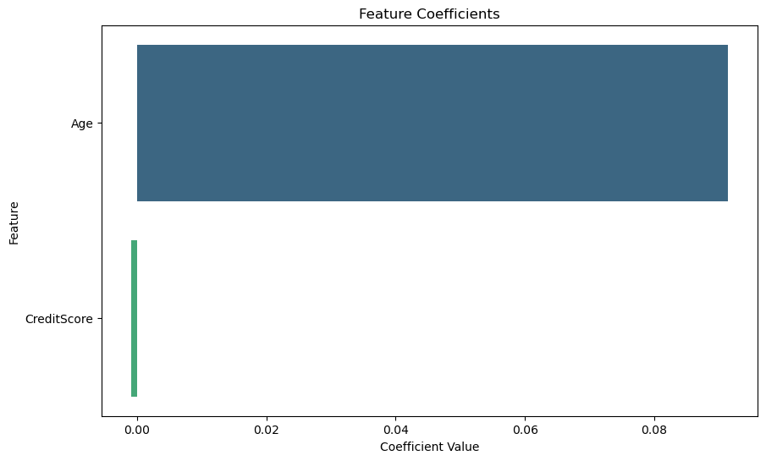
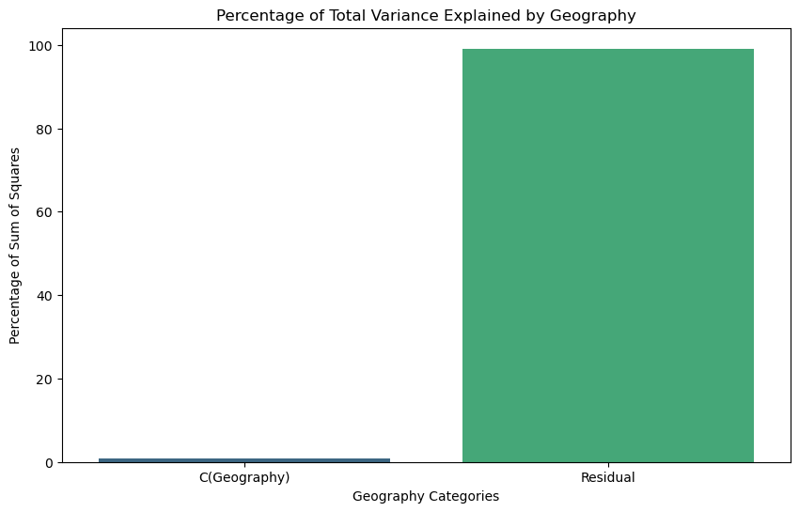
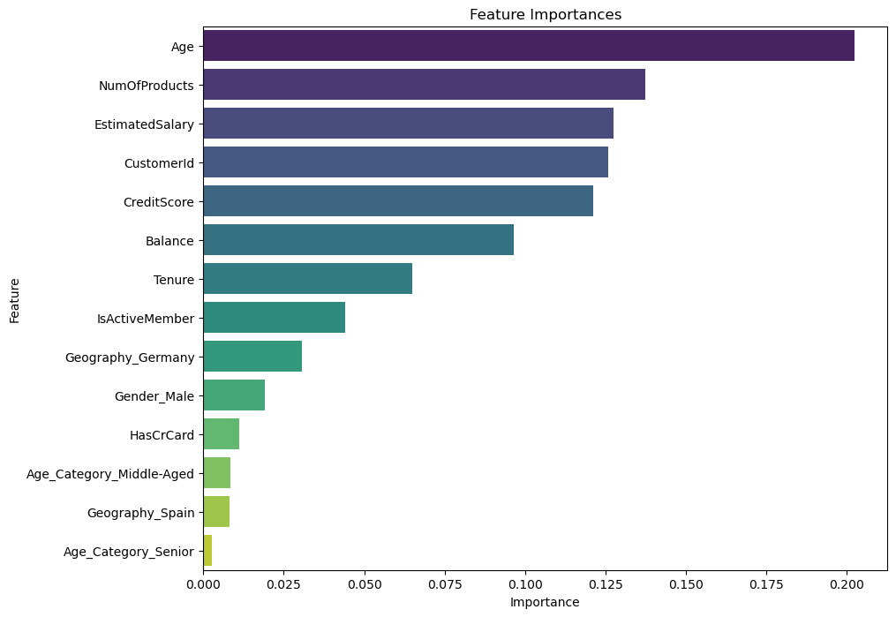
Statistical Tests
Age comes out on top over credit score
Geography has no affect

Slide 7
Brief description: "Combines the strengths of RandomForest, GradientBoosting, and DecisionTrees." Final estimator: Logistic Regression Accuracy and Metrics "Overall Accuracy: 84.92%" Precision for Class 1 (Churn): 70% Recall for Class 1 (Churn): 50% F1-Score for Class 1 (Churn): 58% Confusion Matrix | | Predicted: No | Predicted: Yes | |---------------|---------------|----------------| | Actual: No | 36,892 | 2,241 | | Actual: Yes | 5,227 | 5,151 | "Highest overall accuracy among tested models." "Balanced approach to precision and recall." "Effectively reduces the cost of false predictions by improving precision for churn prediction." Business Impact "Optimal for scenarios where both false positives and false negatives have significant cost implications." "Requires more computational resources but provides robust predictive power."
Best Model for the job

Slide 8
Strategic Implications for Bailey's Bank
Develop or enhance financial products that cater specifically to the needs of older adults, such as high-yield savings accounts, retirement planning services, and age-specific investment options.
Offer reverse mortgage products or equity release schemes that allow older customers to leverage their home equity for additional financial security.

Slide 9

Strategic Options to attain and keep Older Customers​
Implement a dedicated service team trained to address the unique needs and concerns of older customers, providing a more personalized banking experience.
Use relationship management techniques to maintain regular contact and provide proactive advice as financial needs evolve over time.
Improve the usability and accessibility of digital banking platforms to accommodate older customers, including larger text, voice-assisted technology, and simplified navigation.

Slide 10
Dynamic delivery​
Learn to infuse energy into your delivery to leave a lasting impression​
One of the goals of effective communication is to motivate your audience
Metric​ | Measurement​ | Target​ | Actual​
Audience attendance​ | # of attendees​ | 150​ | 120​
Engagement duration​ | Minutes​ | 60​ | 75​
Q&A interaction​ | # of questions​ | 10​ | 15​
Positive feedback​ | Percentage (%)​ | 90​ | 95​

Slide 11
Final tips & takeaways​
Consistent rehearsal​
Practice makes perfect, so strengthen your familiarity with the presentation​
Refine delivery style​
Pacing, tone, and emphasis​
Timing and transitions​
Aim for seamless, professional delivery​
Practice audience
Enlist colleagues to listen & provide feedback​
Seek feedback​
Reflect on performance​
Explore new techniques​
Set personal goals​
Iterate and adapt

Slide 12
Summary of findings Recommendationfor Bailey's Bank and Future steps

Slide 13
Older customers are more likely to churn and less likely to choose Baileys. We must change our view of older customer engagement
Conclusion
Engagement can include tailored communications based on individual preferences and behaviors. Older customers may prefer more direct and personal communication channels, such as phone calls or face-to-face interactions
Senior-Friendly Products:
Develop or enhance products that specifically cater to the financial needs and goals of older adults. This could include higher interest savings accounts, retirement planning services, and age-appropriate investment options.
Provide incentives for product usage that are appealing to older demographics, such as bonus interest rates or fee waivers.

